Slide 1

Monthly thing
추천 시스템

Slide 2
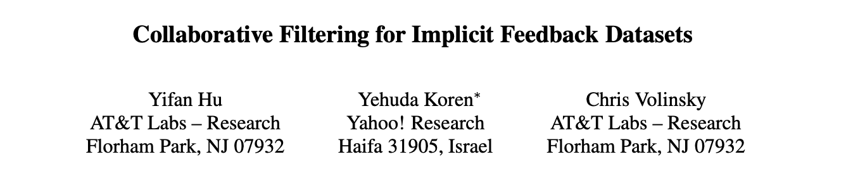
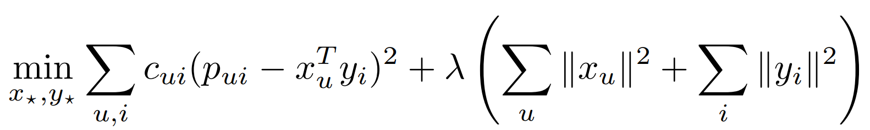
ALS Model
Published in: 2008 Eighth IEEE International Conference on Data Mining (ICDM)

Slide 3

Neural Collaborative Filtering (NCF)
Published in: International World Wide Web Conference (WWW)

Slide 4
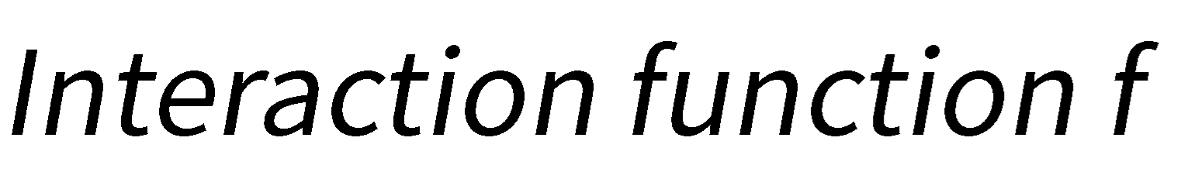






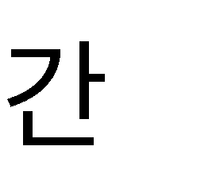




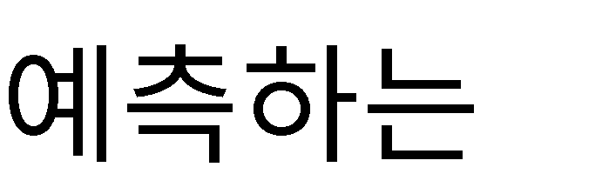

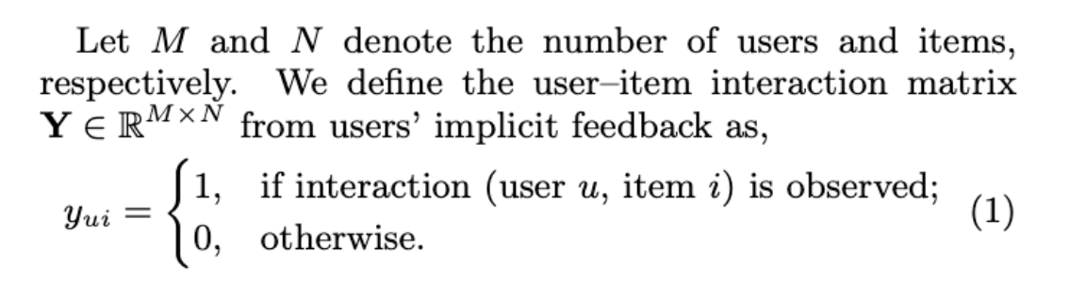
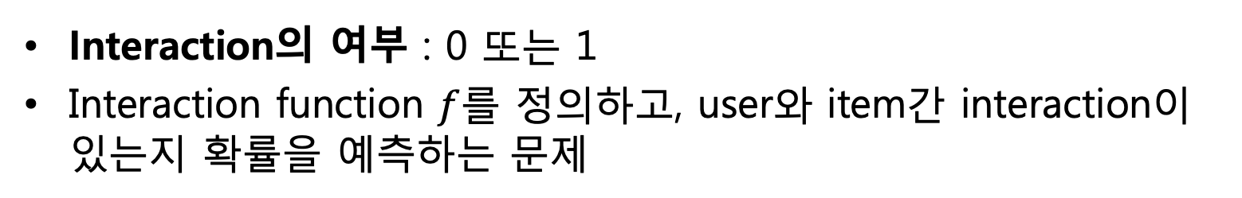
Learning from Implicit Data
Interaction의 여부 : 0 또는 1
Interaction function $f$를 정의하고, user와 item간 interaction이 있는지 확률을 예측하는 문제

Slide 5
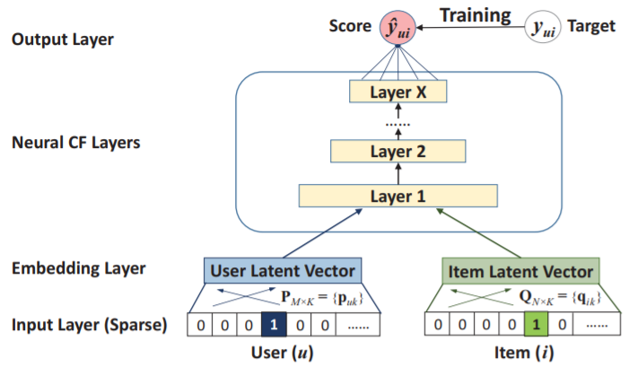
Neural Collaborative Filtering (NCF)

Slide 6
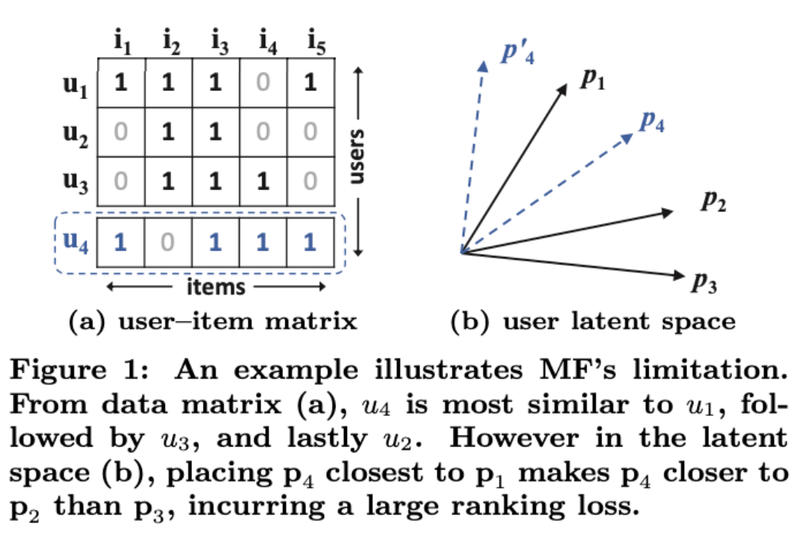
User-Item Interaction Matrix
User-Item Matrix의 한계
U4-> U1>U3>U2
P4-> P1>P2>P3
복잡한 관계를 Low dimension에 표현하면서 문제 발생
Nonlinear한 Neural Network를 사용해서 복잡한 상관관계 표현 (기존 linear MF의 한계 보완)

Slide 7
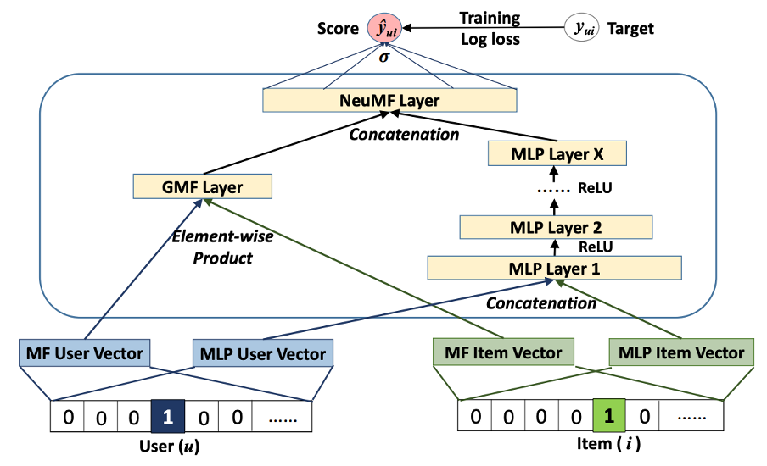
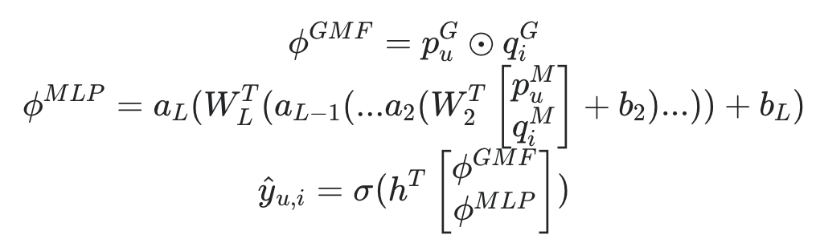
Neural Matrix Factorization Model (Fusion of GMF and MLP)

Slide 8
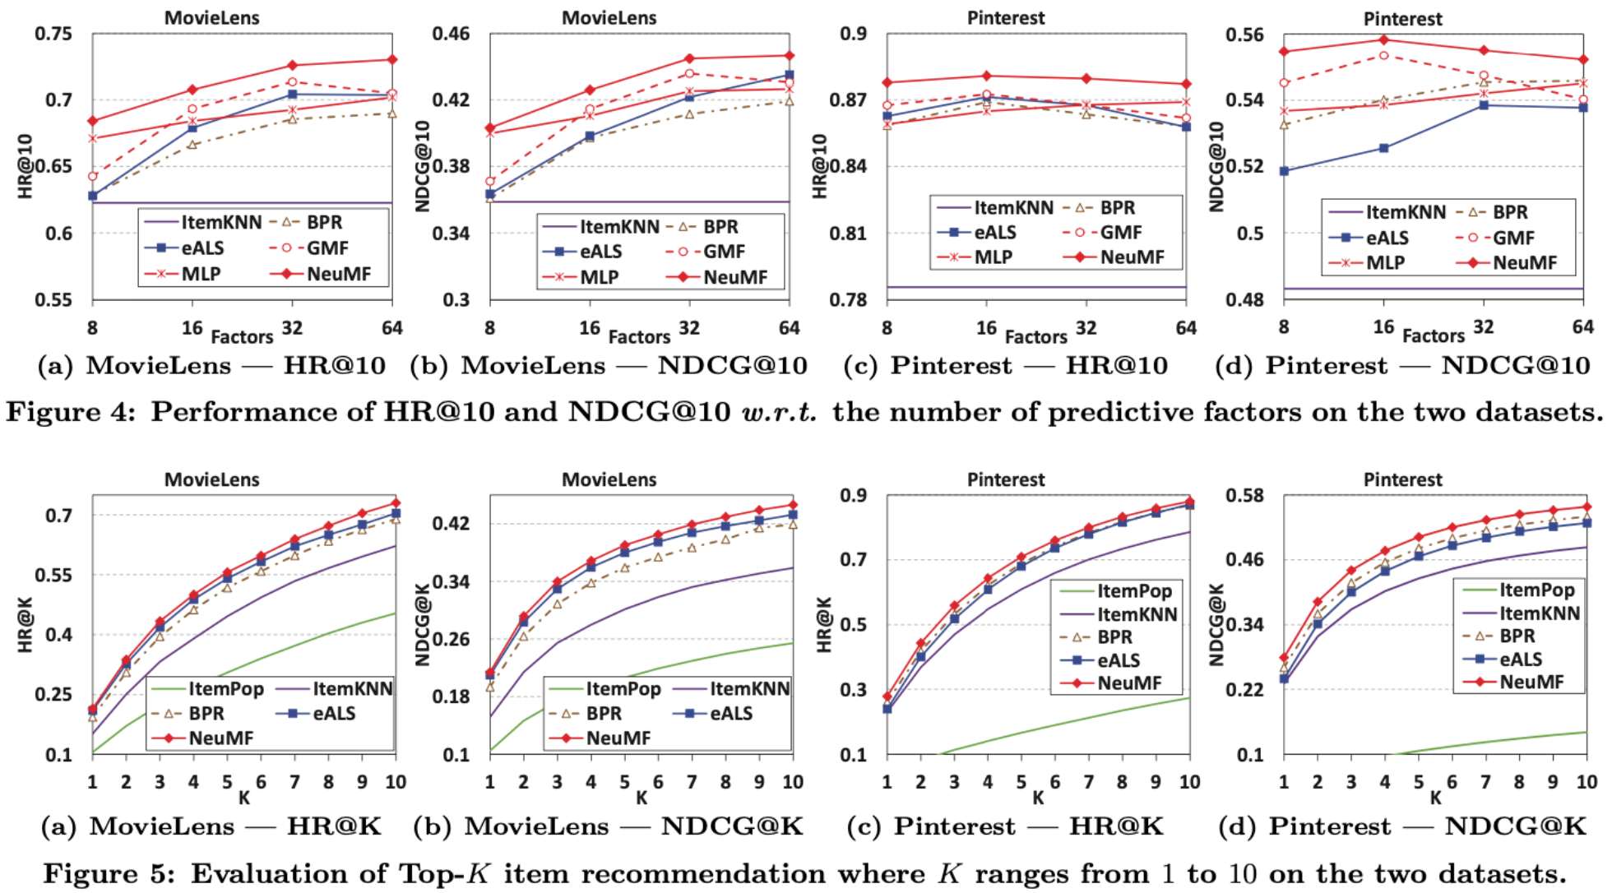
Experiments : Performance Comparison

Slide 9
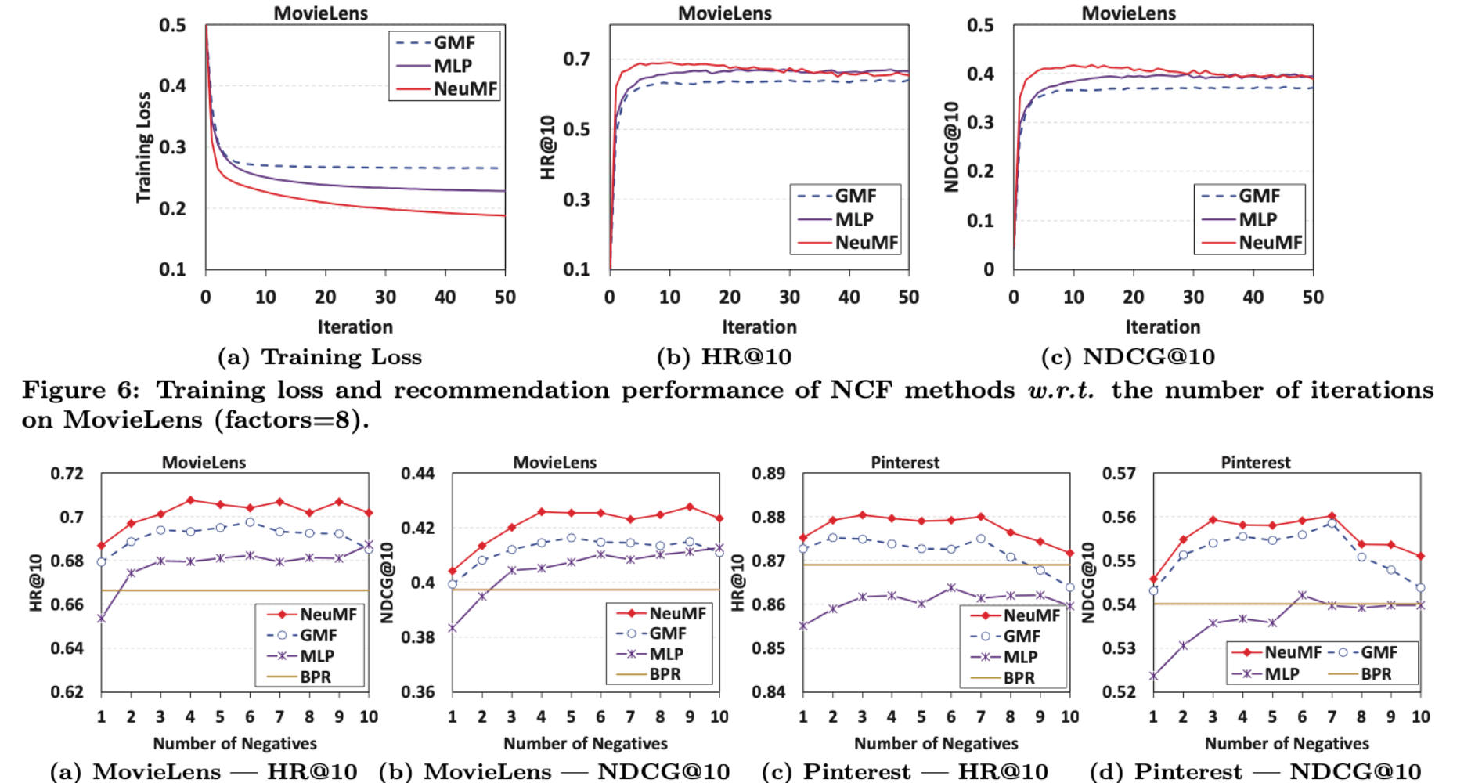
Log Loss with Negative Sampling

Slide 10
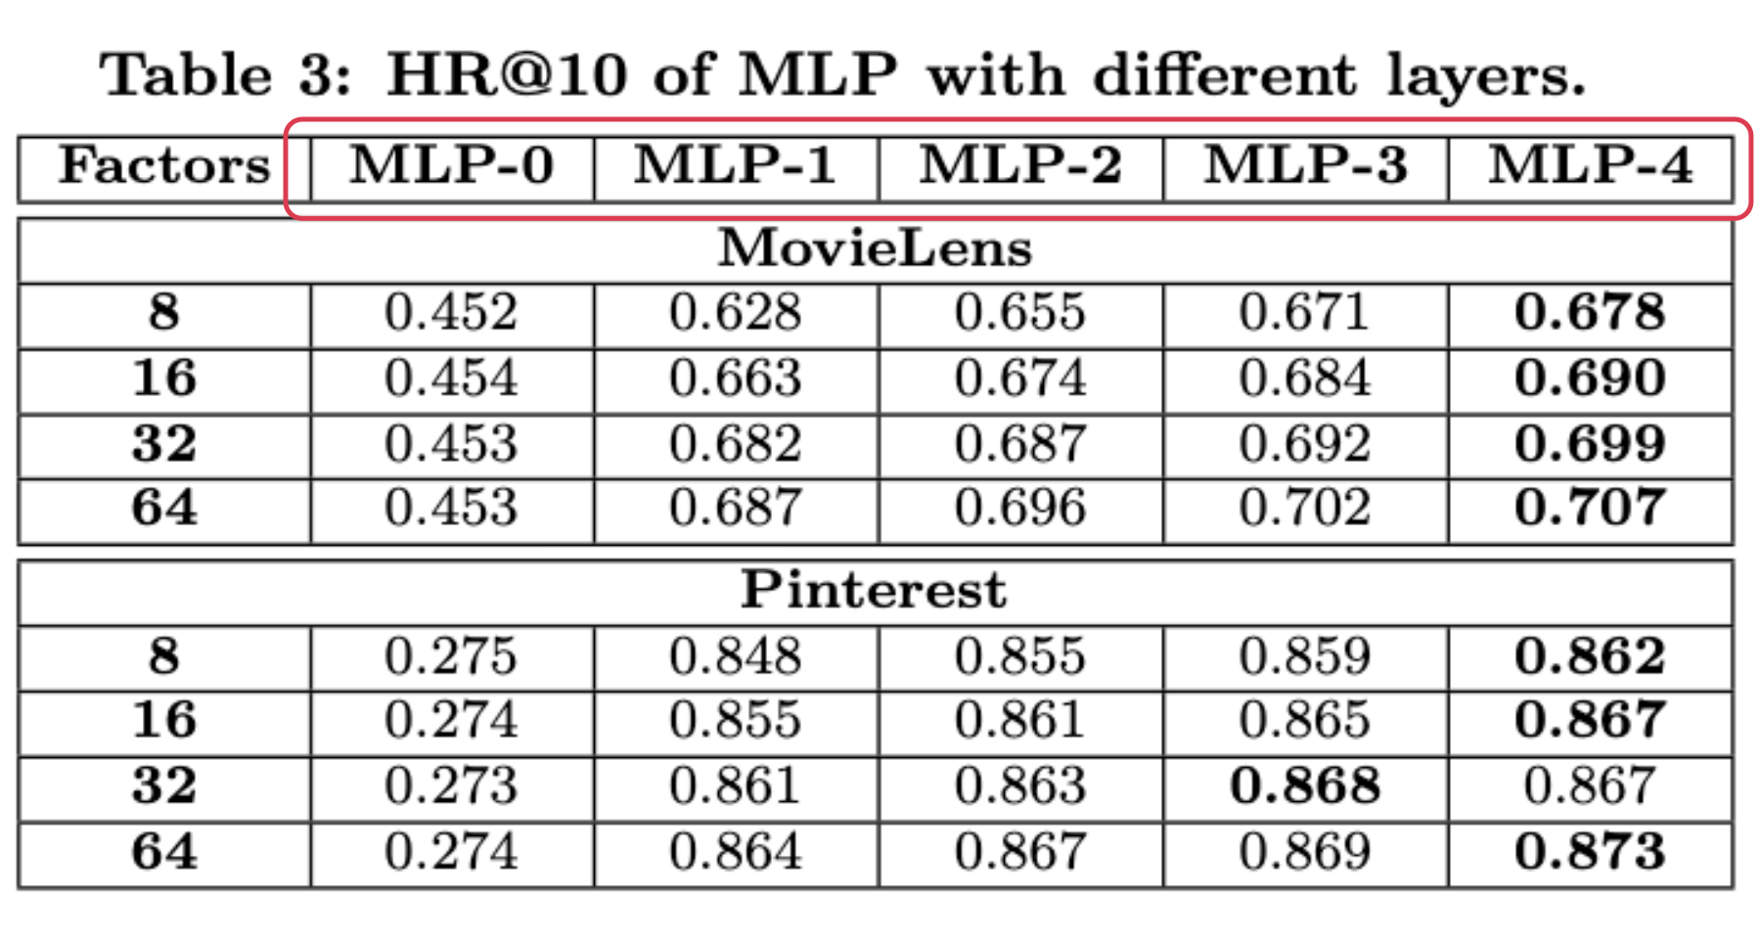
Experiments : Is Deep Learning Helpful?

Slide 11
NEXT PLAN
NEUMF Model learning from Monthlything Implicit data
ALS Model learning from Monthlything Implicit data
Comparison

